Slide 1



Peeking Behind the NAT An Empirical Study of Home Networks
Project
BISmark
Sarthak Grover, Mi Seon Park, Srikanth Sundaresan, Sam Burnett, Hyojoon Kim, Bharath Ravi, Nick Feamster
School of Computer Science, Georgia Institute of Technology
Notes:
This work presents the first view into Internet connectivity and usage in home networks

Slide 2




What is Happening in the Home Network?
How are home networks connected to the Internet?
How do different devices connect in the home network?
How do users use the Internet?
Home
Network
Internet
Notes:
Still too low level – need a higher level slide
Firstly, connectivity of the home network to the internet itself, after that a more detailed view of connectivity of devices in the home, and lastly the usage of the shared home network across devices

Slide 3
Questions
Connectivity to Internet
How frequently do home networks disconnect?
Device connectivity inside the home
Are there connectivity patterns?
How crowded is the Wi-Fi?
Internet usage
Do users saturate their links?
Does usage differ across devices?
Availability
Infrastructure
Usage
Characteristics
Notes:
Explain triangle properly
Q1 is important for a regulators monitoring the ISP
Q2 is important for ISPs and users – who might want to demand more spectrum
Q3 is important for users to know about their own usage of networks, and ISPs for identifying traffic patterns
//d/g: Connectivity outside the hn, then connectivity inside the hn, finally a look at the traffic in the hn

Slide 4
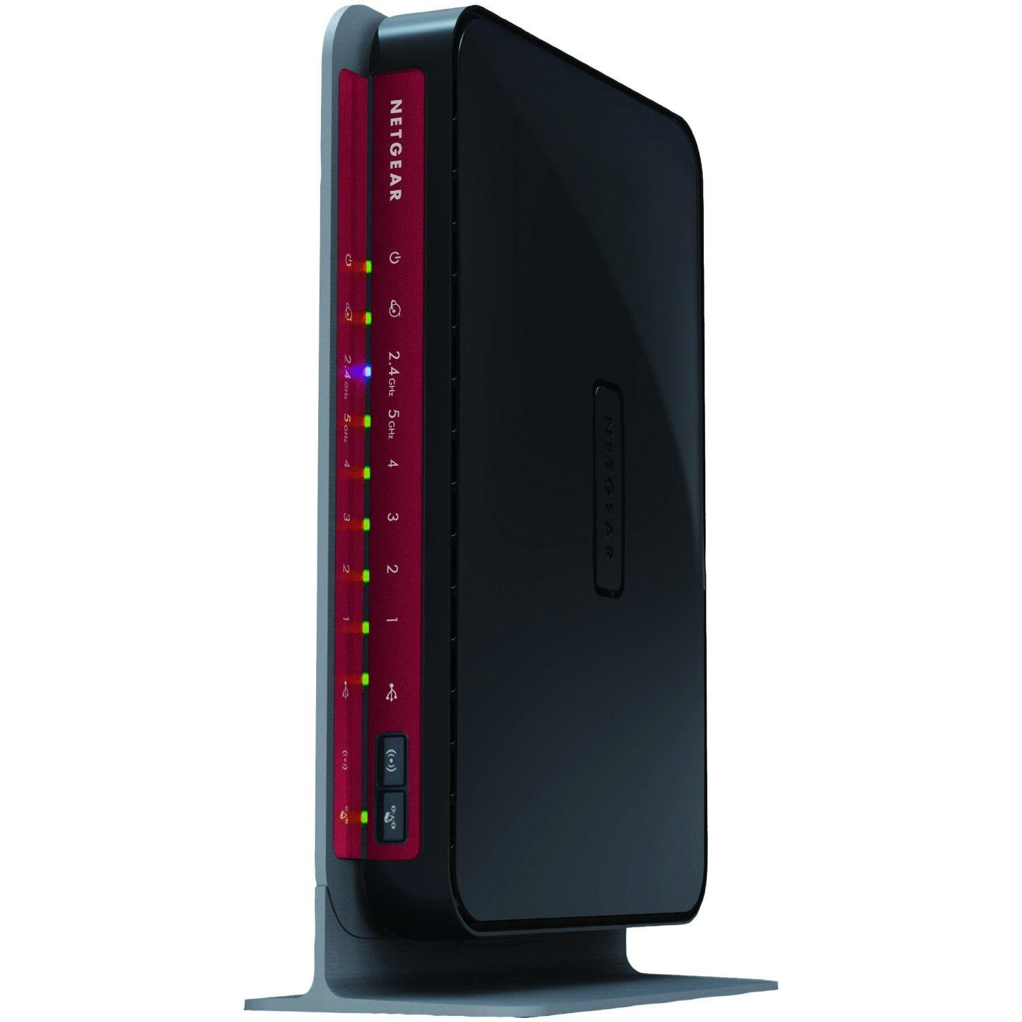

Project BISmark: Peeking Behind the NAT
We require a device inside the home network
See all devices
Performs continuous measurements
- Gateway to Internet
- Programmable
Internet
Home
Network
BISmark
Notes:
To answer these questions
Can look at all the devices – connectivity and the usage
Continuous measurements to let us observe properties of home networks over time
So, we use bismark routers – programmable gateways sitting between the internet and the home network
- automated monitoring and measurement through access point lets us study availability, infrastructure, usage characteristics of a home network

Slide 5
Limitations of Previous Studies
Home network performance has been measured from server or end-host
Not longitudinal
Lacks view of NAT
Design studies for home networks rely exclusively on human subject interviews
Not quantitative
Notes:
There has been some previous effort into studying hns. But they don’t tackle the questions we have asked in this work comprehensively.
Approach – uses server side or end host side measurement platforms so Not continuous measurements over time – look at devices inside the NAT
automatic quantitative measurements are accurate and can reveal observations which are not obvious to users.
Our approach of using the bismark platform overcomes both these weeknesses

Slide 6
Our Contributions
Availability
Analyze Internet connectivity to home networks
User behavior affects access link connectivity
Infrastructure
Study the wireless spectrum usage in homes
Wireless device connectivity has a diurnal pattern
Usage characteristics
Analyze traffic patterns by device and domains
Users don’t saturate their links
Notes:
In todays talk, I’ll show a few highlights from our paper. I’ll start with the availability of a home network and show that user behave affects the connectivity, then look at the connectivity of devices inside the home network concentrating particularly on the wireless spectrum in homes, and finally delve into some interesting characteristics of home network traffic.

Slide 7
Availability of Home Gateways
Why measure home network connectivity?
To monitor ISP performance
To develop pervasive applications
Connectivity can be measured using periodic heartbeat probes
Missing heartbeats indicates a downtime
Access network is offline
Router is offline
Notes:
Why do we want to measure avail of home gateways?
Regulators and users want to monitor ISP performance, connectivity is an important parameter
Why this study is imp is for developing context-aware pervasive applications, a lot of work has gone into modeling network availability patterns mathematically
In this work we measure the availability by simplying ping the server from router every minute
If we don’t get pings for 10 mins we say that a downtime has occurred – and this can happen due to the network being offline or due to the router being offline.

Slide 8
Developing Nations See More Downtime
Developed nations
30
Developing nations
1
Why such a large difference?
Average number of days between downtimes
Notes:
We analyzed the frequency of downtimes in our heartbeats dataset and found that, on an average there are 30 days between consecutive downtimes for a developed nation. In contrast, routers in developing nations suffered downtime almost every day. But why was there such a large difference in the number of days between 2 downtimes?

Slide 9
User Behavior Can Cause Downtime
Always-on
Nights
Access network problem
Days
Some users switch off their routers when not in use
Intermittent
Diurnal
Weekends
Weekdays
Weekends
Notes:
To explore this in more depth we studied connectivity of the routers over a few days.. Here I’ll show a sample of the patterns we saw. Let gray denote night hours, light gray weekends. We could basically classify the access link availability into 3 categories:
Most routers in developed nations had a link which was always connected
Sometimes we saw that the link had intermittent connectivity, and we confirmed that this was due to a problem in the network.
Some routers from developing nations showed us a curious pattern in downtimes – connectivity was observed during evening hours, and on the weekends – i.e. a diurnal connectivity pattern. Turns out, the network was not at fault here but in fact router was being switched off when not in use. The point is, that users may be using home gateways as an electrical appliance – switching it off to save electricity or due to data caps, and this can cause so called downtime.

Slide 10
Our Contributions
Availability
Some users switch off their routers causing downtime
Infrastructure
Study the wireless spectrum usage in homes
Wireless device connectivity has a diurnal pattern
Usage characteristics
Users don’t saturate their links
Analyze traffic patterns by device and domains
Notes:
Next we’ll look at some of the technologies inside the HN infrastructure, in particular the wireless connectivity. Other results on wired connectivity and devices in the home are in the paper.

Slide 11
Infrastructure in Home Networks
Why study devices and technologies used inside the home network?
Reveal connectivity patterns we didn’t know about
Measure how crowded the spectrum is
Infrastructure can be studied by monitoring
Devices connected to home router
Other APs seen on the same channel
Notes:
Why is the study of infrastructure important. One reason is
To study connectivity patterns we didn’t know about
Users know their wifi is bad due to neighborhood interference, and regulators can use this study and approach to request more spectrum.
Important to users and regs who want to know how crowded the neighborhood is.
We study the infrastructure by regularly recording the number of devices connected to the router to expose connectivity patterns if any, and we monitor other access points seen from the gateway to get a hint about the neighborhood interference on the same channel as the router.
//(Furthermore cognitive radios develop schemes to sense and switch channels [Xeng2009] – this study can provide insight into channel occupancy)

Slide 12
Connectivity is Diurnal on Weekdays
Weekdays
Number of Devices
Weekends
Morning
Afternoon
Evening
Night
Notes:
Looking at connectivity of devices over the day
For weekends the number of devices seemed more consistent throughout the day
For weekdays though, number of devices decreased during the afternoon and went back up again after the evening, presumably because the user is at work during the afternoon phase.

Slide 13
2.4 GHz Spectrum is Crowded
>60
10
Neighborhood APs
Devices
5
20
Bi-modal distribution
Notes:
Next we look at the 2.4 GHz spectrum, in particular 1. the devices connected on the 2.4 GHz interface, and 2. the neighborhood APs on the same channel as the home gateway on 2.4 GHz. By default this is channel 11 but a user may change this as needed.
We see that on an average the router sees 5 connected devices in the home network on 2.4 GHz. In some homes, this number may be as big as 10 devices.
We also see that on an average the router sees 20 other access points on the same channel as itself. In some cases, the number of neighborhood APs seen is more than 60!
Interestingly, this distribution of neighborhood access points seen is actually bimodal – so we see either around 3 devices on avg, or as much as 20.
So 2.4 GHz is crowded for HN and this may be a cause of bad wifi at times.
In the paper we also present similar results for the 5 GHz interface.

Slide 14
Our Contributions
Availability
Some users switch off their routers causing downtime
Infrastructure
2.4 GHz spectrum is overcrowded
Usage characteristics
Analyze traffic patterns by device and domains
Users don’t saturate their links
Notes:
So after looking at the availability of the HN, and the infrastructure in a HN, we reach the final part of the presentation, a look at the traffic usage in a home network.
In this section I’ll talk about traffic patterns we observe, and compare actual usage with access link capacity.

Slide 15
Home Network Usage Characteristics
Why measure home network traffic?
Compare total traffic utilization to access link capacity
Reveal usage patterns differ by source or by destination
Passive monitoring of traffic (with explicit content)
Packet and flow statistics
DNS responses to user customizable whitelist
Notes:
Why do we want to measure usage characteristics. For one,
Important for users to know if their bandwidth is sufficient for their usage, or if they are underutilizing the link.
ISPs may be interested in seeing usage patterns – esp if usage patterns can give us a hint about the device being used.
But to measure the actual traffic usage and characteristics, we need to look at packet and flow statistics. Being PII information, we gained explicit permission from a subset of bismark users to install bismark-passive experiment, which lets us passively monitor the traffic in a home network.
Packet statistics to estimate total traffic utilization of access link, flow statistics to see usage by device,
DNS responses to see traffic to particular domains
We explain the information collected by bismark-passive in more detail in the paper

Slide 16
Users Don’t Saturate Their Links
100 Mbps
Capacity
Large difference between traffic utilization and access link capacity
Traffic Utilization
20 Mbps
Time
Half the houses saturate less than 50% of the available capacity
Notes:
So first, we compare the actual traffic in a home network to the estimated capacity of the access link. Using banwidth measurement tools, we estimated the active link capacity of the network, for example in one case it was 100 Mbps. Next looking at precise packet timings and packet lengths, we estimated the traffic utilization of the link. In this example, the actual traffic usage peaked to only about 20 Mbps occasionally. In such cases we see a huge gap between the utilization of the link and the available link capacity.
In fact, out of the 25 homes with bismark-passive installed that we analyzed for this work, 13 used less than half the available capacity in downlink. And only 2 houses actually saturated their uplink, the rest used less than 50% of the capacity in uplink. The two houses which did end up saturating the uplink were actually continuously uploading scientific data to a server.

Slide 17
One Device Generates Most Traffic
Most traffic is due to a single usage hungry device
60%
Usage Fraction
20%
long tail
Most used device
Least used device
Notes:
After the overall traffic utilization, we analyzed traffic usage by home device. What we found was that home networks tend to have a “most used device” which contributes to most of the traffic. In our analysis, the most used device in homes accounted for an average of 60% of the total data passing through the access point. The second most used device contributed 20% of the traffic on an average, and this was followed by a long tail depending on the number of devices .
Thus we can say that most traffic in home networks is due to a single usage hungry device.

Slide 18
More Traffic by Volume, Less by Number of Connections
Most popular whitelisted domain (by volume)
14%
Traffic by connections
2nd most popular domain
7%
11%
38%
Traffic by volume
Popular domains tend to serve streaming content over long-running TCP connections
Notes:
Up until now, we’ve counted traffic usage in terms of amount of traffic generated from a particular source. We can also analyze traffic to a particular domain based on the domain responses we can look at. Thus another criteria which we can use to analyze traffic usage is the number of connections to a particular domain.
In this graph, we plot the fraction of traffic by volume to the most popular domain, versus the fraction of traffic by number of connections to the same domain. We see that traffic by volume accounts for 38% whereas there were only 14% of the total connections to that same domain. Similarly, traffic to the 2nd most popular domain accounts for 1% of the volume but only 7% connections. This implies that popular domains serve streaming content over long-running TCP connections.
Note that we use a default whitelist to look at domain responses only from the top 200 alexa popular websites. This whitelist is user customizable. Any domain not on the whitelist is anonymized.

Slide 19
Summary
Availability
Some users switch off their routers causing downtime
Infrastructure
2.4 GHz spectrum is crowded
Usage characteristics
Users don’t saturate their links
Most traffic is due to a single usage hungry device
Traffic to most popular domains from home networks are over long-lasting connections
Notes:
Availability – monitor ISPs, design better context aware pervasive applications
Infrastructure – Regulators open 5 GHz spectrum in certain countries, (cognitive radio schemes which switches between channels for one with least interference)
Usage characteristics – cool for users, refutes the claim that only user profiling is important as usage varies across devices, show that home broadband is unsaturated - may be useful for sharing?

Slide 20
Teasers
Most frequent and long lasting downtimes occurred in countries with lowest GDP per capita.
Even though wireless devices exceed wired devices considerably, more than half the homes have at least one wired device. All four ports are rarely used.
Different types of devices have different most popular domains.
Notes:
Top domains by volume for a desktop are different than top domains for a roku box which accesses more streaming content

Slide 21
Future Work
Are users’ perceptions about network use consistent with reality?
Combine network measurement and qualitative studies.
Can ISPs identify device and issue security alerts for suspicious device?
Device fingerprinting using traffic patterns.
How does Internet usage differ across countries?
Broader deployment: expansion to more countries
Contact us if you want a cool BISmark router for free!

Slide 22

Thank you!
Get our data at:
http://uploads.projectbismark.net
http://data.gtnoise.net/bismark/imc2013/nat
Get involved:
http://projectbismark.github.io/
Contact:
www.gtnoise.net/~sarthak
sgrover@gatech.edu
Notes:
Our paper gives the gory details about each of the datasets we collect

